Slide 1
Case Study on Material Selection for Automobile Silencer
Course Name: Materials for Engineers, ME1000
Dr. Vikash Kumar
Dept. of Mechanical Engineering
Room 108J
vikashkumar@iiitdm.ac.in

Slide 2
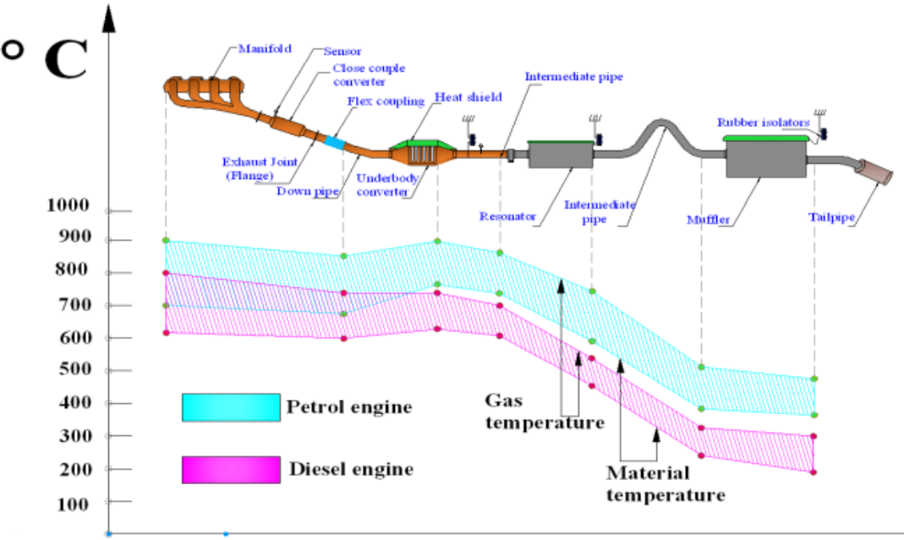
What is an Automobile Silencer?
It’s a device used to reduce the noise produced by the exhaust gases of the engine.
The size, shape and construction varies according to the type and size of the engine.
It is a part of the exhaust system of an automobile.

Slide 3
Technical Aspects
Process of Manufacture:
Sheets are cut into the required size, shaped with the help of power presses, edge folding machines and bending rollers.
Gas welding is then done to join the sheets and finish the silencer.
Finally they are spray painted, cleaned and packed.

Slide 4
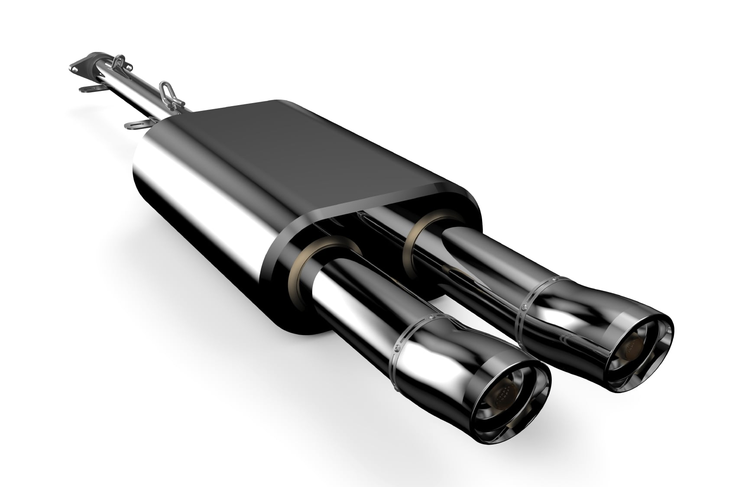
Purpose of the Silencer
To sustain vibration generated due to high pressure exhaust gas.
To reduce the noise emitted by a vehicle.
They reduce the noise by dampening the pulsations in the exhaust gases by allowing them to expand slowly.

Slide 5
Working Requirements of a Silencer
The maximum temperature in the exhaust system is around 750-850 ⁰C. So the material should be able to withstand these temperatures.
Other factors such as high temp. oxidation, de-icing, salt contamination and wet corrosion by condensates.
Mild Steel was used earlier. However, now the use is only in non-corrosive environment.
Material should have the following characteristics:
High service temperature, high fatigue strength, high fracture toughness, machinability, economic, highly resistant to corrosion.

Slide 6
Criteria for Material Selection of Silencer
The choice of the material is decided by the best possible combination of material properties.
a) Functional properties: The correct combination of mechanical, physical and chemical properties to meet the functional requirements.
b) Manufacturing properties: should be easy to convert the material to required shape (ease of casting, forming, joining and machining).
c) Economic: cost of material and cost of processing the material should be bearable, availability and recycling aspect should also be accounted for.

Slide 7
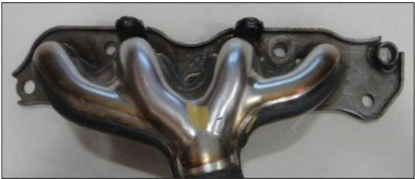
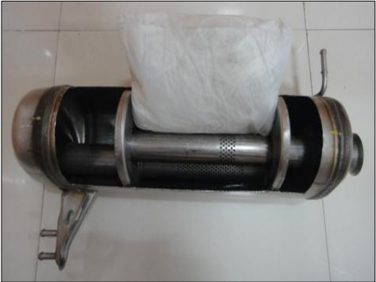
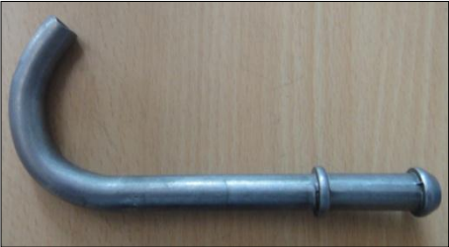
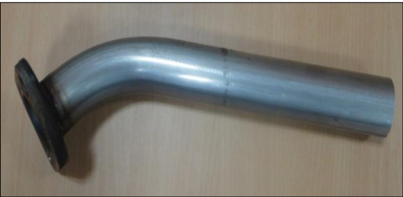
In reality, both material and process selection must be considered simultaneously since not all materials are compatible with every process.
Example: steel, nickel and titanium cannot be die cast, ceramics cannot be machined using conventional techniques. And complexity of shape limits the process choice further.
Components of the exhaust system, (from left to right) exhaust manifold, muffler assembly, hangar rod and intermediate pipe.

Slide 8
Metal combinations used Worldwide
Aluminized steel:
Attempt to make material more corrosion resistant, aluminized coating oxidizes to protect the underlying metal. However, any abrasion on the coating compromises in inner material.
Stainless steel:
They offer some protection from weathering and damage, but it will also eventually rust.
Cast Iron:
Used mainly for exhaust manifold, very strong but heavy. It will also eventually rust and become brittle over time.
Alloying metals:
Chromium, nickel, manganese, molybdenum, silicon and titanium.

Slide 9
Effects of the alloying elements on Stainless Steel.
Element | Effect
Chromium | Oxidation resistance increases at Cr levels above 10.5%. High content can adversely affect fabric ability and weld ability.
Nickel | Enhances mechanical properties and fabrication characteristics. Can minimize damage of surface oxide during temperature cycling.
Manganese | In moderate quantities, performs many functions attributed to nickel. Interacts with Sulphur to form manganese sulphide which affects corrosion resistance. Improves adhesion of oxide film and improves oxidation resistance.
Element | Effect
Molybdenum | In combination with chromium is very effective for passive film stabilization in the presence of chlorides. Effective in increasing resistance to the initiation of pitting and crevice corrosion.
Carbon | Provides strength in high temperature applications. Detrimental to corrosion resistance through reaction with chromium to form chromium carbide. Detrimental to toughness in ferrite grades.

Slide 10
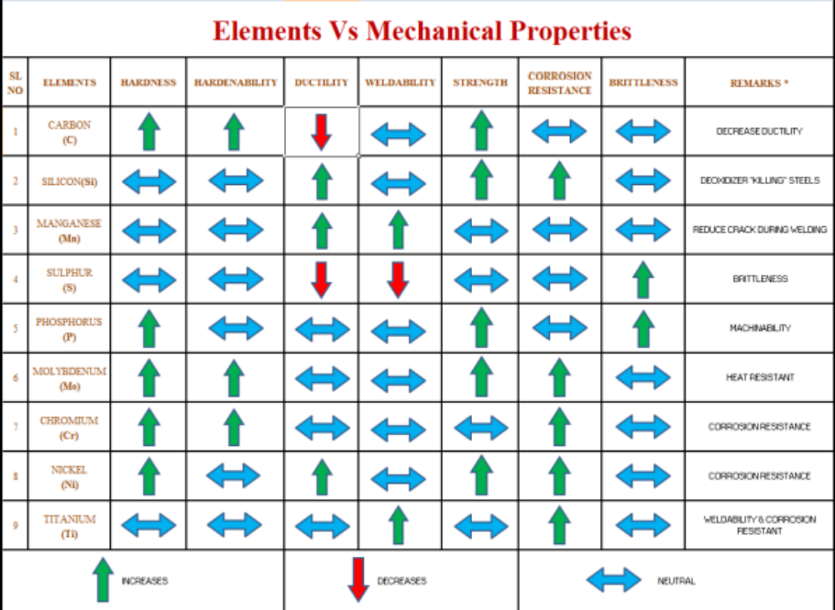

Slide 11
Some Materials used for Silencers
Material | C | Mn | Si | Cr | Mo | Ni | Ti
SUS441L | 0.02 | 0.56 | 0.63 | 17.59 | 0.01 | 0.27 | 0.28
SUS439L | 0.02 | 0.25 | 0.65 | 17.13 | - | 0.28 | 0.36
SUS436LM | 0.01 | 0.06 | 0.09 | 18.18 | 0.89 | 0.30 | 0.29
SA1D | 0.01 | 0.15 | - | - | 0.02 | - | 0.05
STKM12A | 0.13 | 0.14 | 0.04 | 0.01 | 0.03 | 0.17 | -
STKM11A | 0.09 | 0.56 | 0.13 | 0.11 | 0.06 | 0.11 | -
Material | Yield Strength (N/mm²) | Tensile Strength ( N/mm²) | Elongation (%) | Hardness (HV) | Thermal expansion coefficient (µm/m/°C) | Service temperature (ºC)
SUS441L | 270 | 480 | 38 | 166 | 10.4 | 950
SUS439L | 260 | 415 | 36 | 165 | 10.2 | 927
SUS432L | 260 | 456 | 32 | 152 | 10.4 | 805
SUH409L | 263 | 427 | 35 | 134
SUS436LM | 281 | 479 | 33 | 152 | 9.3 | 806
SA1D | 198 | 314 | 42.6 | 105 | - | -
SUS430J1L | 323 | 472 | 31 | 169 | - | -

Slide 12
THANK YOU

